Slide 1
JSON and the REST ASP.NET Core
Rasmus Lystrøm
External Associate Professor
ITU
rnie@itu.dk

Slide 2
Agenda
XML (History lesson)
JSON
REST
ASP.NET Core
REST with ASP.NET Core

Slide 3
What is XML?
eXtensible Markup Language
Markup language like HTML
Designed to carry data, not to display data
Tags are not predefined – You must define your own tags
Designed to be self-descriptive

Slide 4
XML Does Not DO Anything
XML was created to structure, store, and transport information
<?xml version="1.0" encoding="UTF-8"?>
<note id="1"> <to>Tom</to> <from>Kathleen</from> <heading>Reminder</heading> <body>Don't forget small change!</body> </note>

Slide 5
How Can XML be Used?
Separates data from HTML
Simplifies data sharing
Simplifies data transport
Simplifies platform changes
Used to Create New Internet Languages
XHTML
WSDL for describing web services
RSS and ATOM for news feeds

Slide 6
What is JSON?
JavaScript Object Notation
Lightweight text-data interchange format
Language independent (uses JavaScript syntax)
“Self-describing” and easy to understand

Slide 7
JSON Syntax
(subset of the JavaScript object notation syntax)
Data is in name/value pairs
Data is separated by commas
Curly braces hold objects
Square brackets hold arrays

Slide 8
JSON Name/Value Pairs
A name/value pair consists of a field name (in double quotes), followed by a colon, followed by a value:
This is simple to understand, and equals to the JavaScript statement:
"firstName" : "John"
firstName = "John"

Slide 9
JSON Data Types
Number (integer or floating point)
String (in double quotes)
Boolean (true or false)
Array (in square brackets)
Object (in curly brackets)
null

Slide 10
Examples
Objects
Array
{ "firstName":"John" , "lastName":"Doe" }
{
"employees": [
{ "firstName":"John" , "lastName":"Doe" }, { "firstName":"Jane" , "lastName":"Doe" }, { "firstName":"John" , "lastName":"Smith" }
]
}

Slide 11
REST
REpresentational State Transfer

Slide 12
REST
Maps your CRUD actions to HTTP verbs
Action | Verb
Create | POST
Retrieve | GET
Update | PUT (PATCH)
Delete | DELETE

Slide 13
HTTP status codes
Code | Meaning
200 | OK
201 | Created
202 | Accepted
204 | No content
301 | Moved permanently
302 | Moved temporarily
400 | Bad request
401 | Unauthorized
403 | Forbidden
404 | Not found
409 | Conflict
500 | Internal server error
501 | Not implemented
503 | Service unavailable

Slide 14
HTTP headers
Header Field | Description | Example
Accept | Content-Types that are acceptable for the response | text/plain, application/json, application/xml
Content-Type | The MIME type of the body of the request (POST and PUT) | application/x-www-form-urlencoded application/json
Authorization | Authentication credentials for HTTP authentication | OAuth realm="http://sp.example.test/", oauth_consumer_key="0685bd9184jfhq22", oauth_token="ad180jjd733klru7", oauth_signature_method= "HMAC-SHA1", oauth_signature="wOJIO9A2W5mFwDgiDvZb…
WWW-Authenticate | Authentication scheme | WWW-Authenticate: OAuth realm="http://sp.example.test/"

Slide 15
Why REST?
Simple, both conceptually and programmatically
Simpler and cleaner than SOAP
REST is the new black
Notes:
SOAP = Simple Object Access Protocol

Slide 16
ASP.NET Core
http://www.asp.net

Slide 17
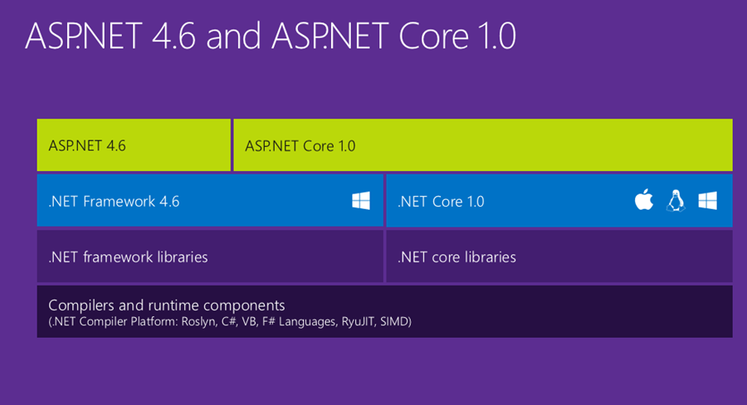

Slide 18
Demo

